Slide 1
Welcome!
To Unit 8
Leadership

Slide 2
Entitled Leadership
Instructor
Prof. Sanjay Kumar Shrestha, Ph.D.
Central Department of Management, Tribhuvan Univeristy Kirtipur

Slide 3
UNIT 8
LEADERSHIP
8.1 concept OF LEADERSHIP
Leader
Follower
Common goal
Influence (formal or informal power)
8.2 TRADITIONAL THEORIES OF LEADERSHIP
Traits theories and behavioral theories

Slide 4
(A) TRAIT THEORIES OF LEADERSHIP
-Leaders are born not made
-physical, psychological traits, etc.
(B) Behavioral theories
-leaders can be made
-specific behavior differentiate leaders form non-leaders.
Ohio State Studies
-Initiating-structure behavior
-Consideration behavior
2. University of Michigan Studies
Production-oriented (Job- centered) leader behavior
Employee-oriented (employee-centered) leader behavior

Slide 5
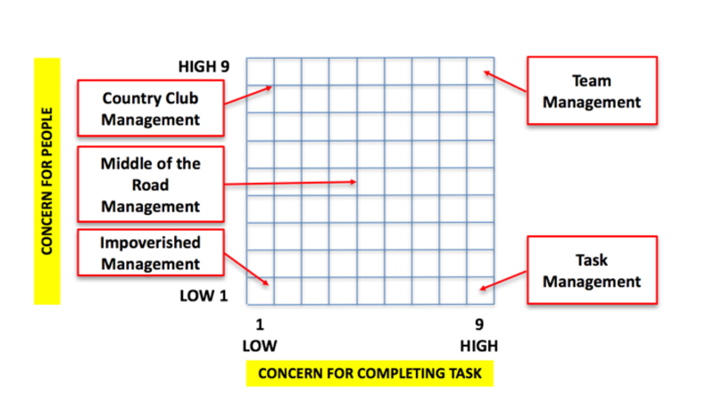
3) The Managerial Grid leadership

Slide 6
8.3 FROM TRAITS TO STATES AND SKILLS DEVELOPMENT
bridge between trait theories to situational theories
positive organizational behavior (POB) constructs optimism, hope, resiliency, emotional intelligence, and especially self-efficacy are related to effective leaders
technical, conceptual, and human skills needed for effective management.
leadership skills such as creativity, organization, persuasiveness, diplomacy and tactfulness, knowledge of the task, and the ability to speak well.

Slide 7
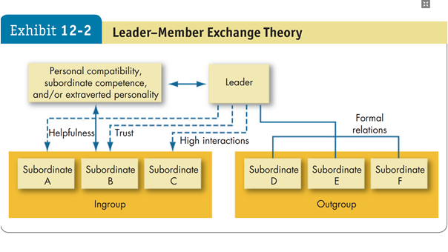
8.4 GROUP AND EXCHANGE THEORIES OF LEADERSHIP

Slide 8
8.5 contingency theory of leadership
Fiedler’s LPC theory
Least preferred coworker theory
trait approach and behavioral approach
2 types of leadership:
Task-oriented
Relationship-oriented
1 to 8 scale for each of the 16 sets of contrasting adjectives
match the leader with the situation

Slide 9
1. Leader-member relations
2. Task structure
3. Position power of leader
-Most favorable situation for task oriented leader
-Good leader-member relations exist.
-Highly structured task of employees
-Stronger leader-position power exists
When relationship leadership is most effective
-Other combinations, i.e. one is high, the other is low

Slide 10
8.6 PATH-GOAL LEADERHIP THEORY
extension of expectancy theory of motivation
leaders are flexible and depending upon situation, any of the 4 types of leadership: Directive, supportive, participative, achievement oriented
Situations:
subordinates’ contingency factors
(b) internal contingency factors

Slide 11
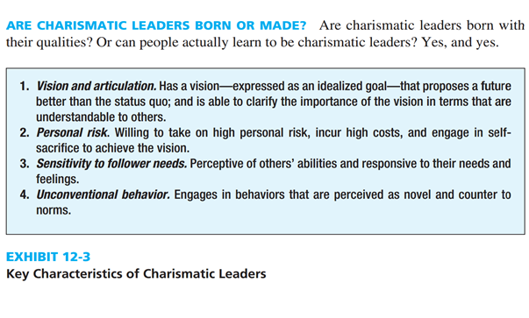
8.7 MODERN THEORETICAL PROCESSES OF LEADERSHIP
(1) CHARISMATIC LEADERSHIP
set apart from ordinary people
exceptional personal charisma/powers or qualities.

Slide 12
(2) TRANSFORMATIONAL LEADERSHIP
recognize the need for change; guide that change
set goals and incentives to push subordinates to higher performance levels, while providing opportunities for personal & professional growth for each employee
shifting values, beliefs, & needs of the followers
seek to empower
goes beyond managing day-to-day operations; taking company/ department, etc. to next level of performance & success.
team-building & collaboration with employees
inspire followers to transcend their self-interests for the good of the organization

Slide 13
Thank You All!
For Your Patience, Comments & Suggestions, and Encouragement!
Dr. Sanjay Kumar Shrestha
Professor, CDM, TU, Nepalse
sanjayjanuary16@gmail.com
98511-999-89

